Slide 1
NAAN MUDHALVAN SCHEME FUNDAMENTALS OF DATA LITERACY WITH TABLEAU Project title: subscribers galore: exploring world’s top youtube channels team id: nm2023tmid09415 team lead id: 036df011915450fbcba437408c97ff10

Slide 2
TEAM MEMBERS ID 587E9449AEA9D69BEF64582A6A096BDB CE7ACADE103FB408B544749519F8E85C BA2EBC1D9175A8684CC48D2CE210B95D Introduction: A subscriber to a channel on the video-sharing YouTube is a user who has chosen to receive the channel's content by clicking on that channel's "Subscribe" button, and each user's subscription feed consists of videos published by channels to which the user is subscribed. The ability to subscribe to users was introduced in October 2005. YouTube began publishing a list of its most- subscribed channels in April 2006. An early archive of the list dates to May 2006. The following table lists the 50 most-subscribed YouTube channels, as well as the primary language and content category of each channel. The channels are ordered by number of subscribers; those whose displayed subscriber counts are identical are listed so that the channel whose current growth rate indicates that its displayed subscriber count will exceed that of the other channel is listed first. Automatically generated channels that lack their own videos (such as Music and News) and channels that have been made effectively obsolete as a result of the transferal of their content (such as Justin Bieber VEVO and Taylor Swift VEVO) are excluded. As of February 2023, 21 of the 50 channels listed primarily produce content in English while 16 primarily produce content in Hindi. All 50 of the channels have surpassed 40 million subscribers, 39 of them have surpassed 50 million subscribers, 23 of them have surpassed 60 million subscribers, 16 of them have surpassed 70 million subscribers, 12 of them have surpassed 80 million subscribers, 10 of them have surpassed 90 million and 7 of them have surpassed 100 million subscribers. Only 1 channel (T-Series) has surpassed 200 million subscribers

Slide 3
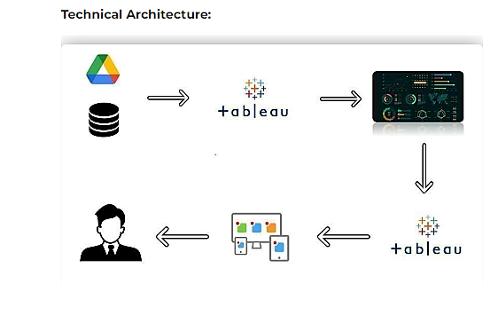

Slide 4
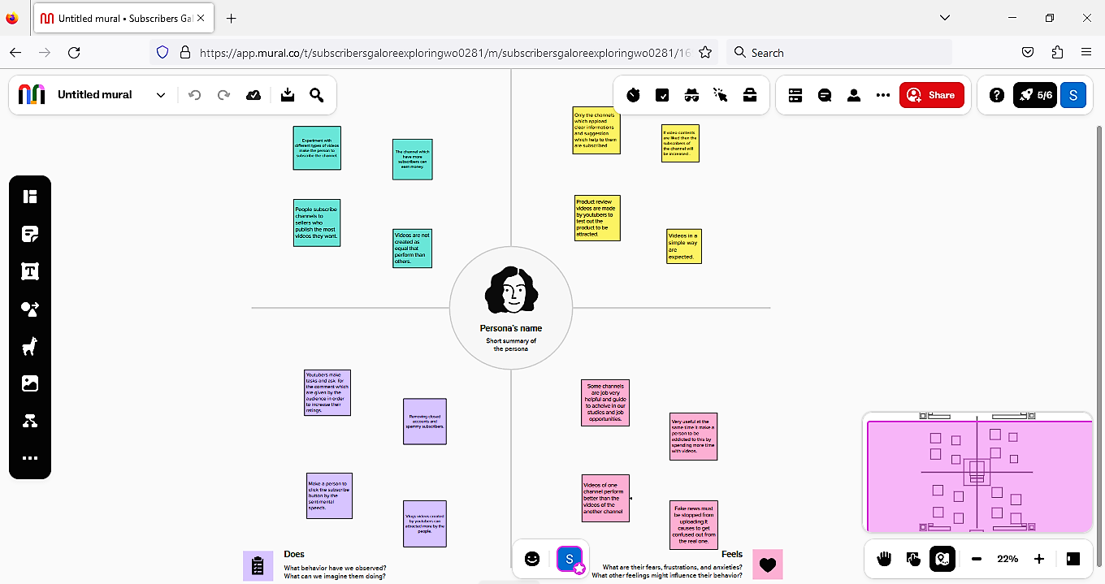
1.DEFINING PROBLEM
EMPATHY MAP

Slide 5
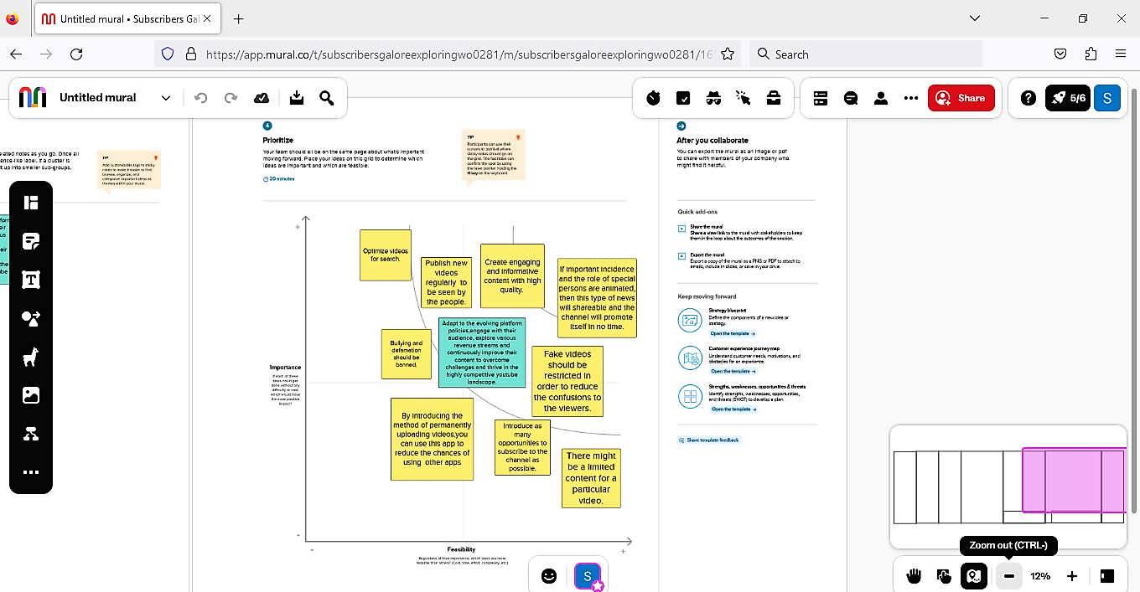
BRAINSTORMING

Slide 6
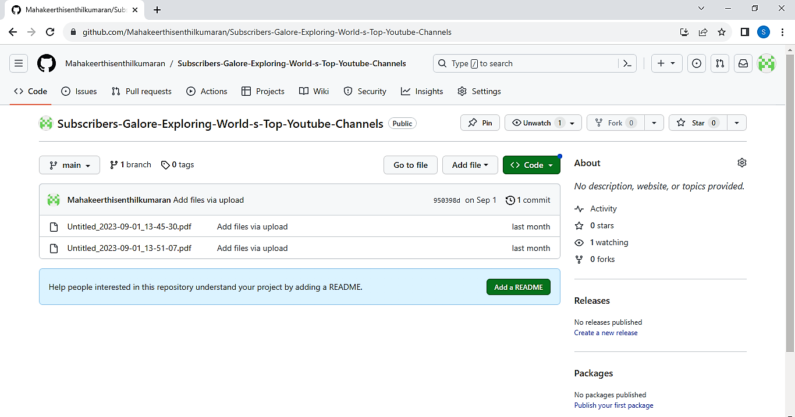
UPLOADED EMPATHY MAP AND BRAINSTORMING ON GITHUB
https://github.com/Mahakeerthisenthilkumaran/Subscribers-Galore-Exploring-World-s-Top-Youtube-Channels

Slide 7
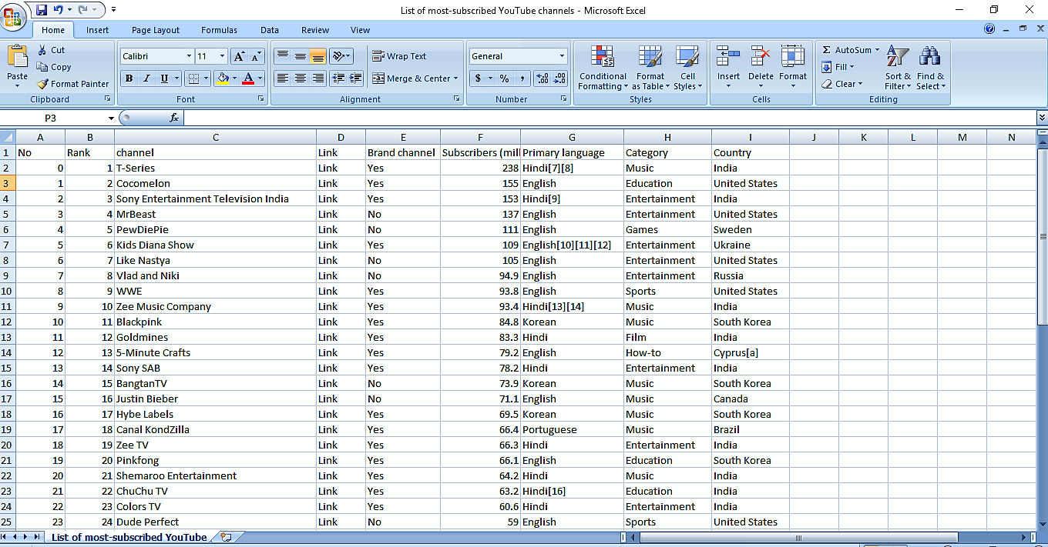
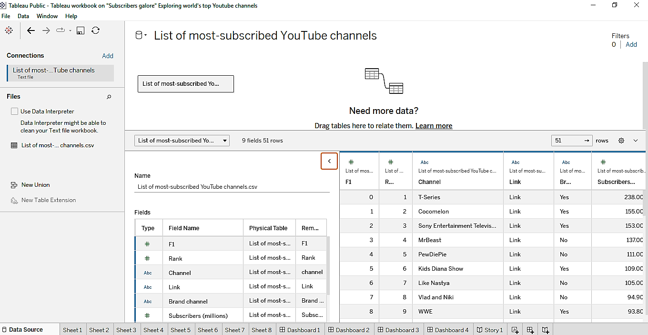
2.DATA COLLECTION AND EXTRACTION

Slide 8
3.DATA PREPARATION
DATA PREPARED FOR THE VISUALIZATION PROCESS

Slide 9
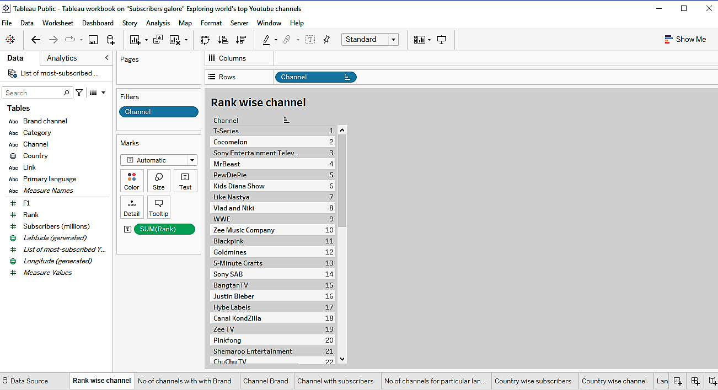
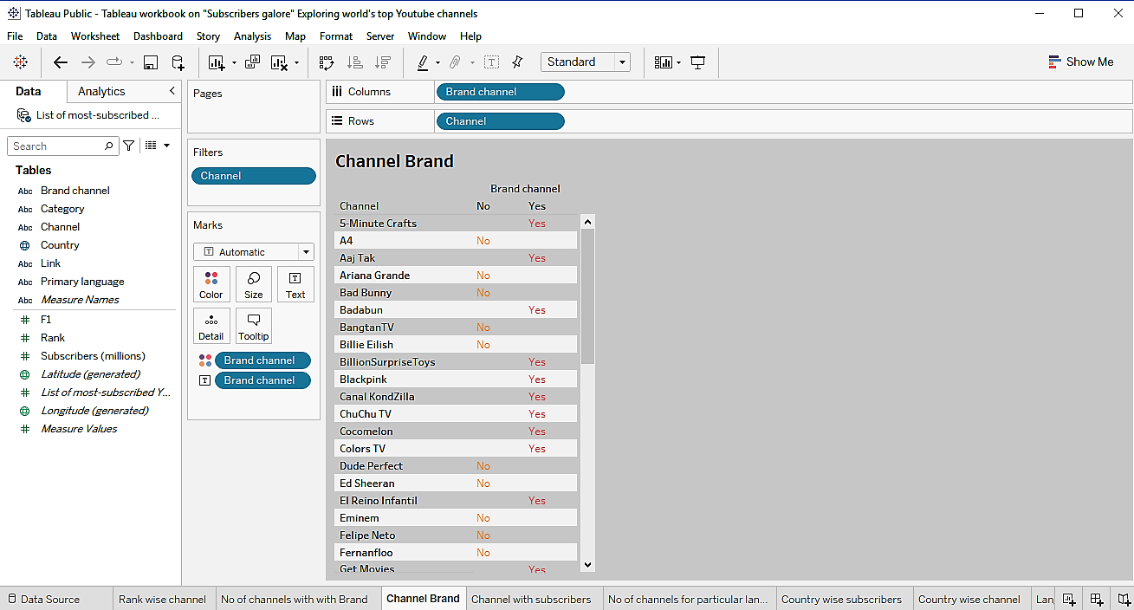
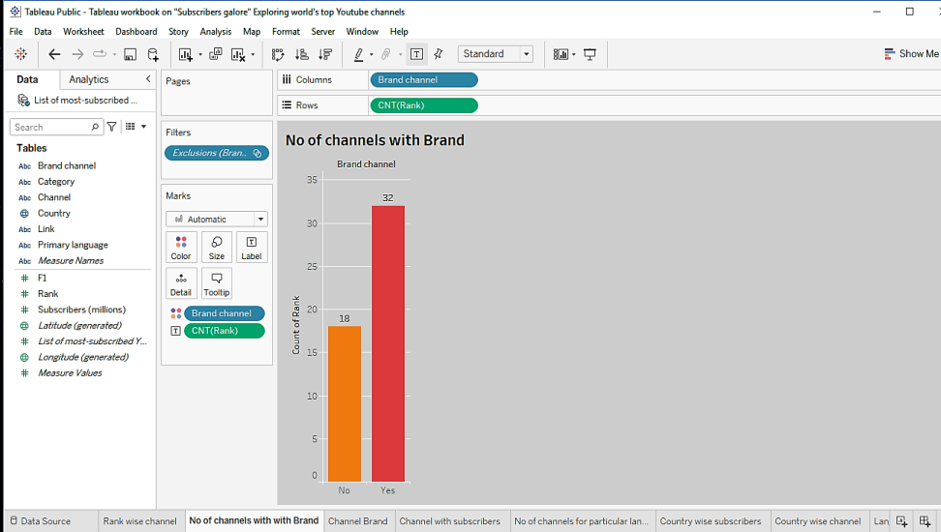
4.DATA VISUALIZATION

Slide 10
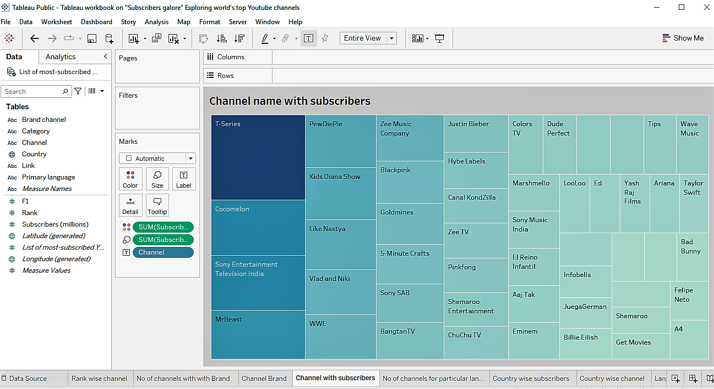
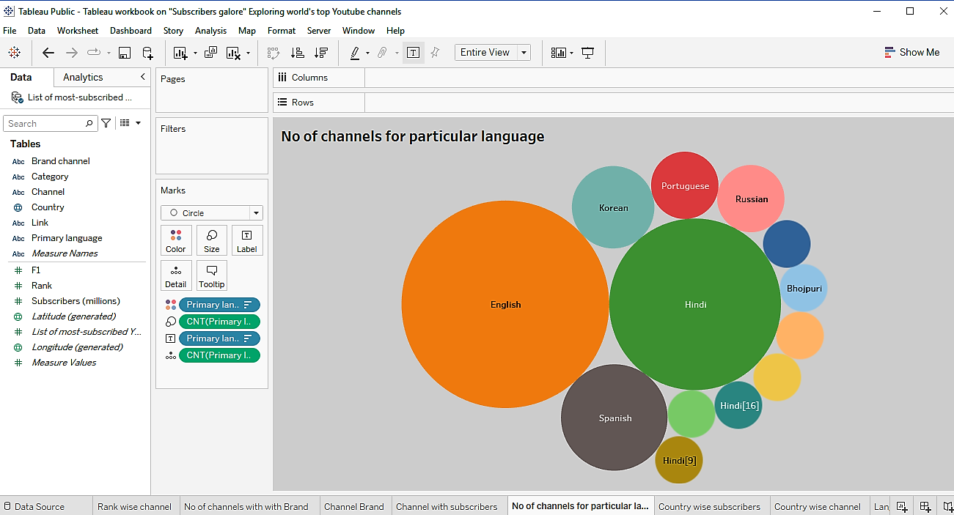

Slide 11
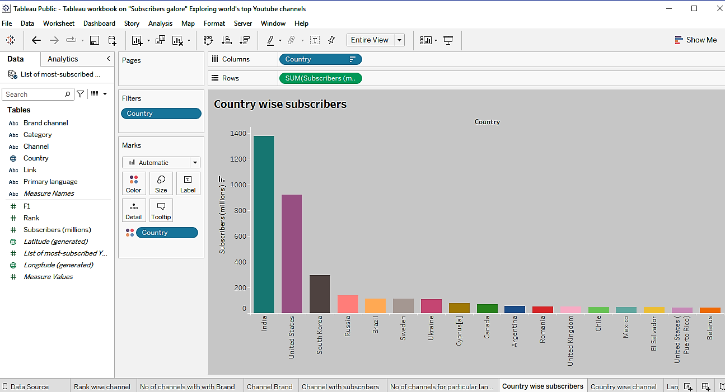
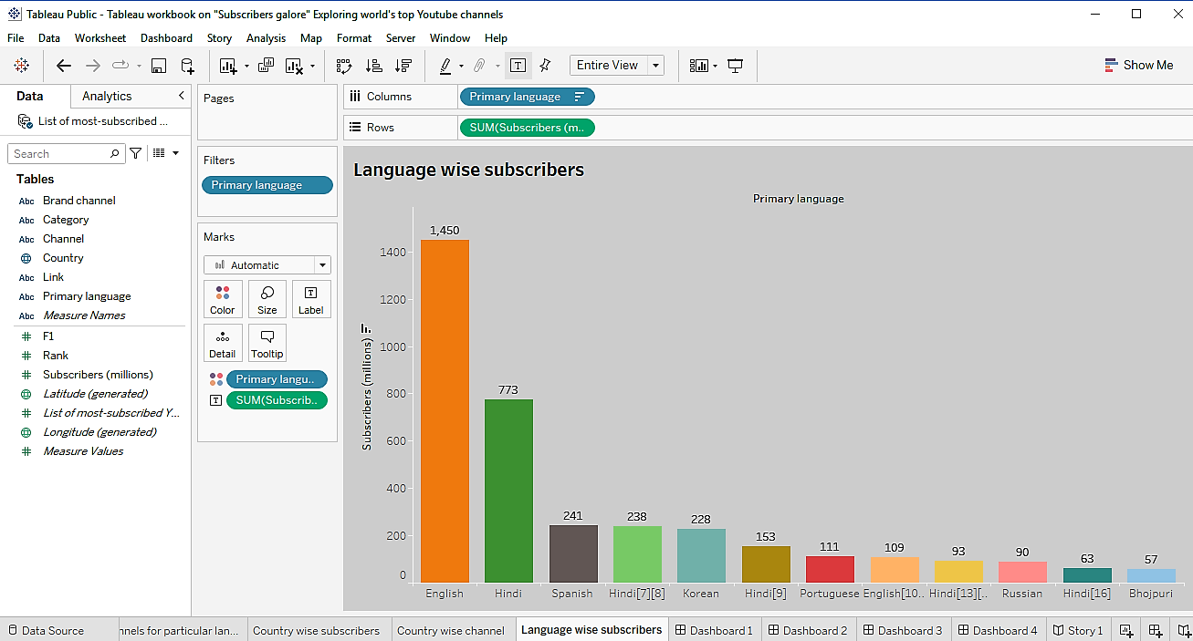

Slide 12
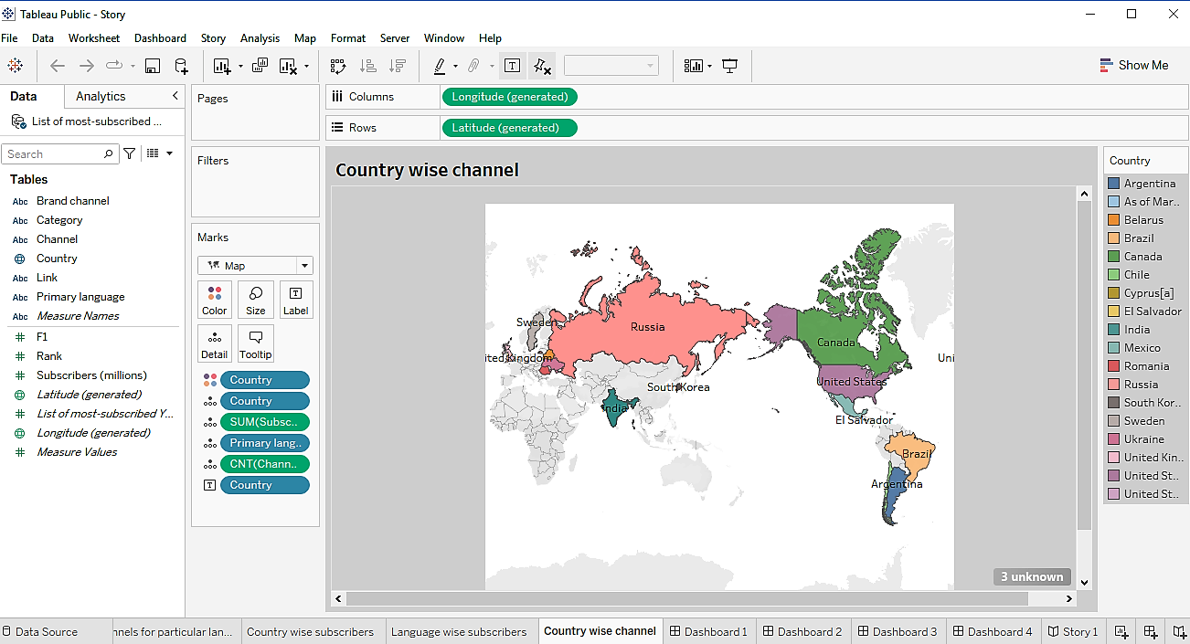

Slide 13
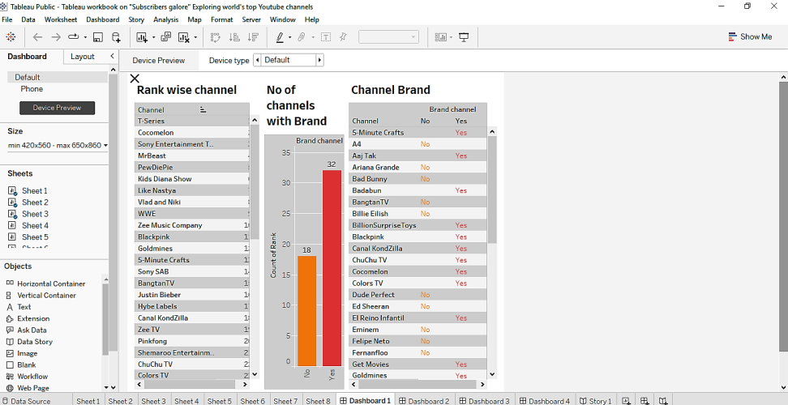
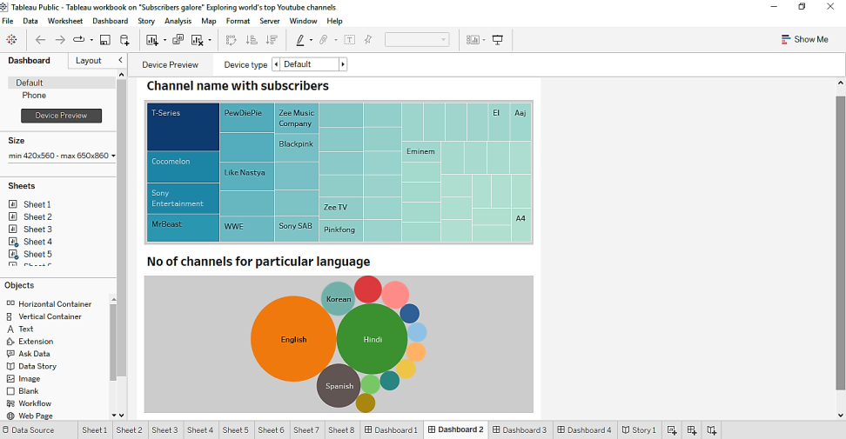
5.DASHBOARD
Rank wise channel , No of channel with brand and channel brand
Channel name with subscribers and No of channels for particular channel

Slide 14
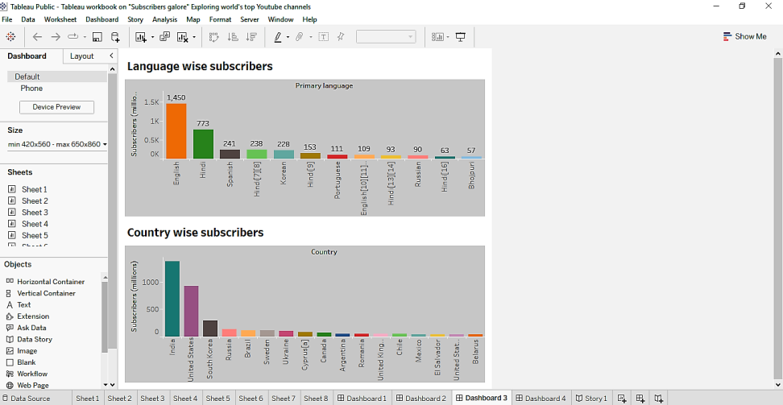
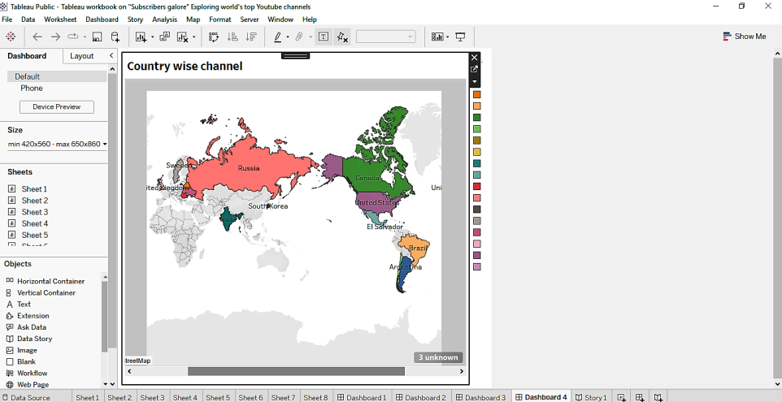
Language wise subscribers and Country wise subscribers
Country wise channels

Slide 15
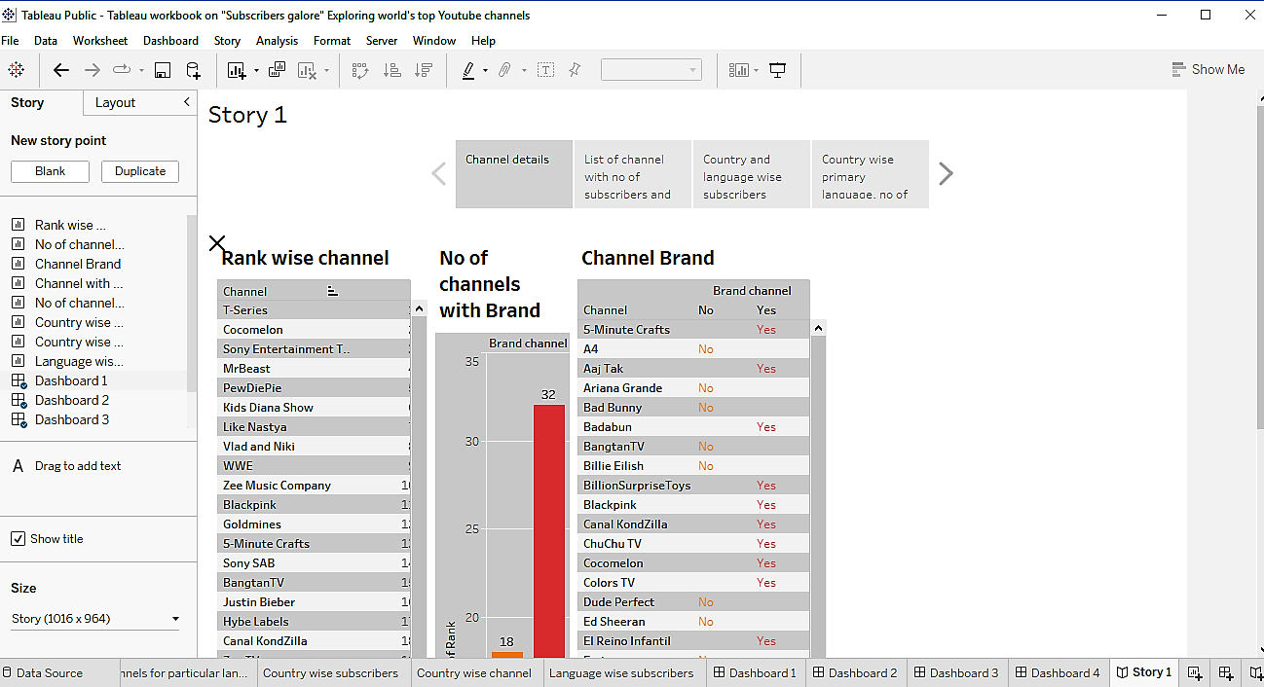
6.STORY

Slide 16
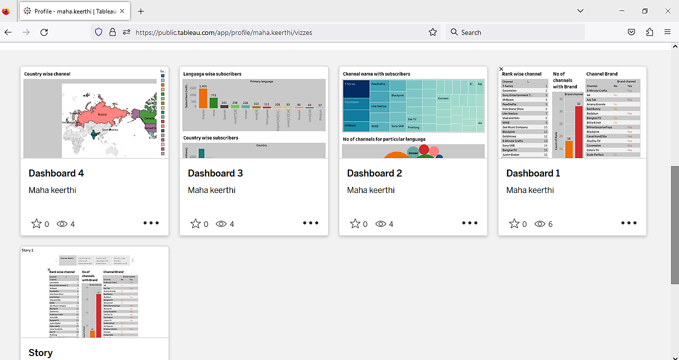
FINALLY PUBLISHED IN TABLEAU PUBLIC
https://public.tableau.com/app/profile/maha.keerthi/vizzes

Slide 17
THANK YOU

